Slide 1
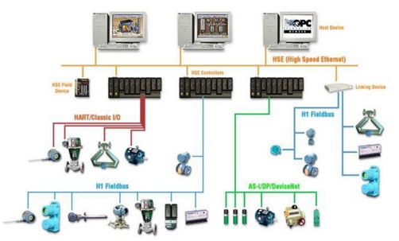
18ECO134T- INDUSTRIAL AUTOMATION
UNIT - 3
Distributed Control system (DCS)

Slide 2
Contents
Session | Topic
19 | Evolution of DCS, Hybrid System Architecture
20 | Central Computer system Architecture, DCS Architecture
21 | Comparison of Architecture, Local Control Unit Architecture
22 | Architectural Parameters, Comparison Of LCU Architecture
23 | LCU Language Requirements, Function Blocks
24 | Function Block Libraries, Problem-Oriented Language
25 | LCU Process Interfacing Issues, Security Requirements
26 | Security Design Approach, On-Line Diagnostics
27 | Redundant Controller Design, One-On-One, One-On-Many Redundancy

Slide 3
Introduction to control techniques
Direct digital control- A single computer controls the entire process. It overcomes the interfacing problems but is vulnerable to failures and shut down
Hybrid control – An individual discrete-control hardware, typically PLCs or analog loop controllers to collect process information and generate reports
Distributed control - allows the application to be broken into subsystems that use digital, rather than analog, control techniques and that can be interfaced together easily.

Slide 4
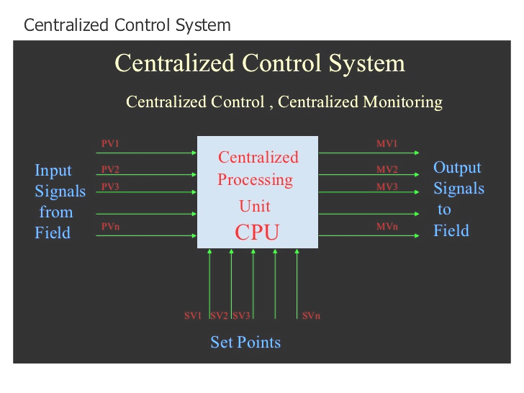
Centralized Control System(CCS)

Slide 5
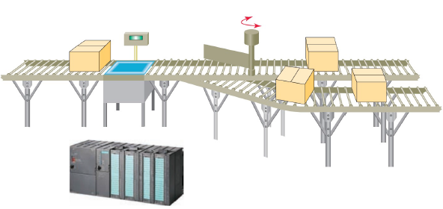
Centralized control
Several machines/processes controlled by a central controller
Control configuration to control diverse manufacturing process with help of a single controller

Slide 6
Drawbacks of centralized control
All individual steps in the manufacturing process are handled by a stand-alone central controller
Simple to implement, monitor and troubleshoot
No exchange of controller status
No exchange of data to other controllers
If the main controller fails, the whole process stops

Slide 7
Hybrid control system
Combination of direct digital control and a central control hardware to implement control functions
Local control of the plant is achieived by means of discrete analog controller
A central monitoring system with SCADA for data logging, control, optimization & alarm management
Dominated approach till 1970s in all industries
Faced difficulties in maintenance of large volumes of data & centralized monitoring of complex industries

Slide 8
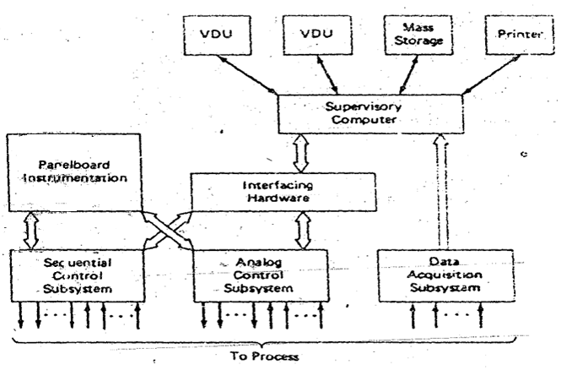
Hybrid architecture

Slide 9
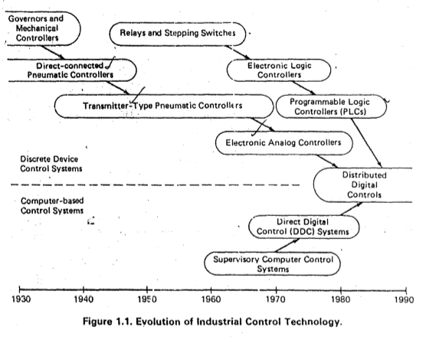
Control architecture-Time line

Slide 10
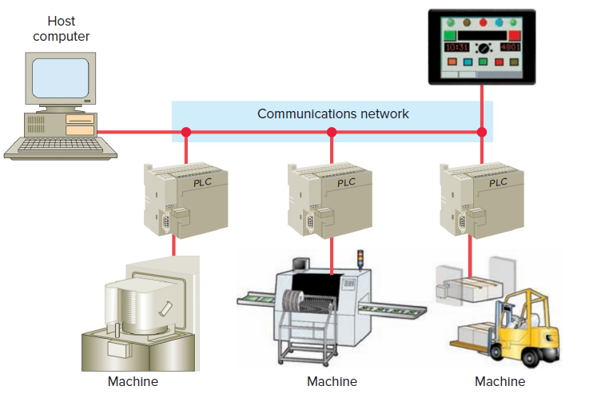
Evolution of Distributed Control System
Distributed Control; Centralized monitoring

Slide 11
Need for distributed control
Distributive control permits the distribution of the processing tasks among several controllers and is highly reliable.
Distributive control drastically reduces field wiring and heightens performance because it places the controller and I/O close to the machine process being controlled.
Depending on the process, one PLC failure would not necessarily halt the complete process.
DCS is supervised by a host computer that may perform monitoring/supervising functions such as report generation and storage of data.

Slide 12
Comparison between CCS and DCS
Centralized control system | Distributed control system
Centralised repository | Distributed/ local repositories
Failure of central controller leads to shut down of the entire process | Distribution of the process tasks among several controllers saves from shut down
Less reliable | Highly reliable
Complexity in process dynamics and control affects the speed of operation | Improved speed of operation
Increased field wiring and hence difficult to troubleshoot | Reduced field wiring and so easier to troubleshoot
Need for dedicated communication links | Distributed communication highways
Low installation but high maintenance cost | High initial cost but low maintenance cost
No such centralised supervision of entire process | Supervision of entire process by means of SCADA software

Slide 13
DCS-Manufacturers
Company
Centum (first DCS unit in the year1975)
ABB
Honeywell
Rockwell
Invensys
Siemens
Emerson
Yokogawa

Slide 14
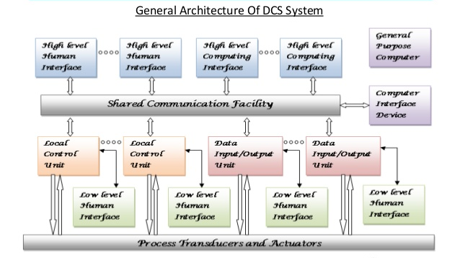
DCS architecture

Slide 15
DCS hardware
Local control unit (LCU)
Data I/O (DIO) modules
Human Machine Interface (HMI)- low and high level
Process interfacing
Shared data communication
Field level communication

Slide 16
Local control Unit (LCU)
Represents a smallest collection of hardware in the DCS setup that performs the closed loop control
Takes inputs from field devices and sensors
Processes commands given by the operator
Controls the output to actuators-motors, solenoids etc.,
Communication between other LCUs
Stand alone operation during changeovers
Changeover from Auto to manual and vice versa

Slide 17
Functions of LCU
It receives the instructions from the engineering station like set point and other parameters and directly controls field devices.
It can sense and control both analog and digital inputs/outputs by analog and digital I/O modules.
It collects the information from discrete field devices and sends this information to operating and engineering stations.

Slide 18
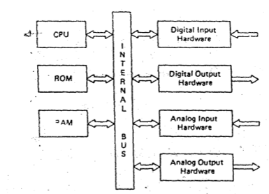
Block diagram of LCU

Slide 19
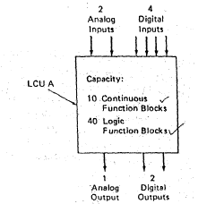
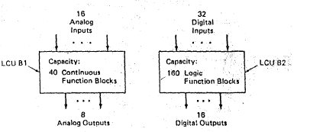
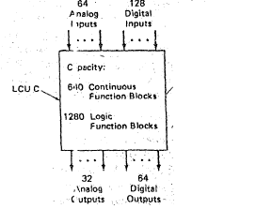
LCU configurations-A,B,C
Configuration A
Configuration B
Configuration C

Slide 20
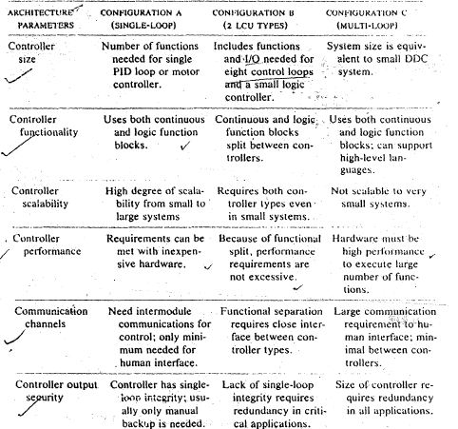
Comparison of configurations
Parameter
Configuration A
Configuration B
Configuration C

Slide 21
Functional Blocks (FB)
To enter the control program and control system configuration in the processor memory of LCU
High level (FORTRAN or BASIC) / block oriented
Blocks with set of parameters can be sequentially connected to implement a particular process
It overcomes the need to learn computer programming
It also helps to avoid manual hardwiring as in the case of relay logic
It helps in easy implementation of the changes to be made in configuration and troubleshooting
Number of FBs used influences the size of the LCU

Slide 22
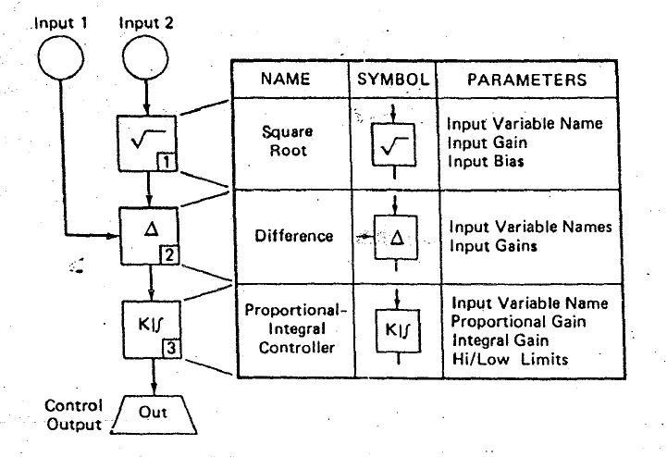
Typical Functional blocks

Slide 23
Functional Block Libraries
2 types of FB libraries:
Complex FB library- for PID controller, sqrt etc.,
Simple FB library- for single arithmetic/logic function
Important factors to be considered- LCU utilization, Flexibility of modification, scalability and difficulty level of implementing algorithms
Important functionalities in High level languages-Text editor, debugger and file manager

Slide 24
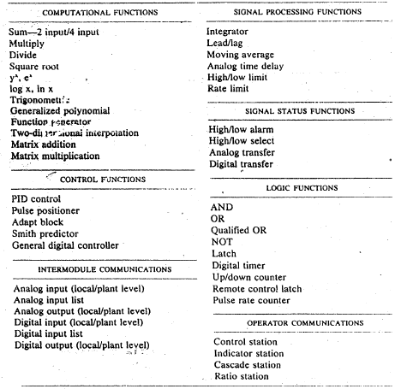
Typical FB libraries

Slide 25
LCU Architecture parameters
Size of the controller- Number of I/Os, processes and functional blocks that can be processed
Functionality- Analog/ Digital, Continuous/ Discrete
Performance – Speed of performance, accuracy, scanning rate etc.,
Communication channels- PC-PC communication, Interface devices, field level communication etc.,
Output security- Fail safe operation, manual or auto backup, frequency of backup and routine checks

Slide 26
Human Machine Interface
Effective Control and visualization of the process
Electronic interfacing between human and the process to control monitor and diagnose processes
Graphical user interface to check:
Operation summary- routine monitoring of process
Configuration/setup- Control configuration and parametric values
Event history-Time stamped list of all significant events
Auto/manual changeover – Bypass control during shutdown/maintenance
Trend values – Flow, pressure, temperatures as a function of time
Diagnostics –cause and occurrence of failures

Slide 27
Interfacing requirements
Communication Interfaces are needed in order to:
Establish communication between LCUs
Allow transmission of process data to higher level elements
Transmit information command and requests to LCUs
Augment I/O capacity of LCU to DI/Ous
Implement redundancy operation of one or more LCUs

Slide 28
Reliable interfacing
For maximum reliability,
Minimise the number of components and electrical connections
Current value of output should be indicated to the LCUs
Powering the output circuitry from an independent supply to avoid loss of data
Analog output device should be able to indicate “last minimum output” “last maximum output” “ go to last output”

Slide 29
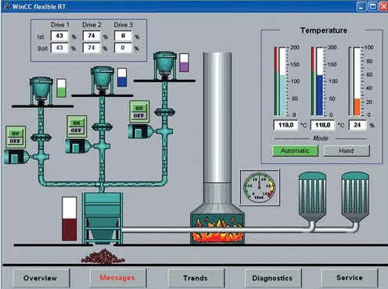
Sophisticated HMI

Slide 30
High Level User Interface
Interfacing with the process
Real time control
Interfacing with other elements in DCS
Security features required for process application
Supporting utilities
Modifying the program

Slide 31
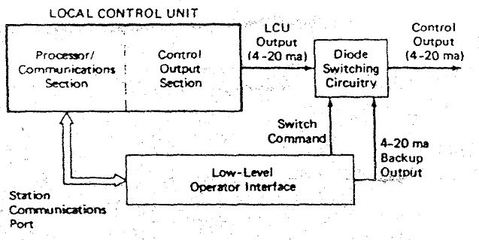
Low level User Interface
Field devices communication
Directly communicates with LCU
Plant operator can directly configure controller, switch control operation and override (Auto/Manual) control

Slide 32
DI/OU modules
A Microprocessor based data acquisition unit meant for receiving and generating inputs and outputs
It can be used as an auxilliary unit capable of handling multiple I/Os (not possible with LCUs)
Adds up to the installation and maintenance cost
Similar to LCU but differs in two ways:
Lack of security features
No control but only data acquisition

Slide 33
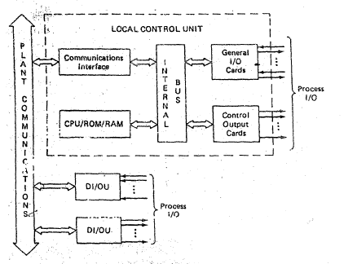
DI/OU Block diagram
Single loop controller
Multi loop controller

Slide 34
Security features
Objectives- safe transmission, Auto/manual switch over during shutdown and fail-safe operations
Three security design approaches:
Manual backup only- Operator can take manual control and link inactive LCU with active ones
Standby redundant controller – One LCU acts as master, remaining are redundant -bumpless transfer
Multiple active controllers- Multiple LCUs active at a time for control operation-decision by polling

Slide 35
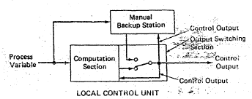
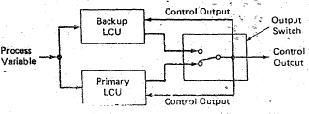
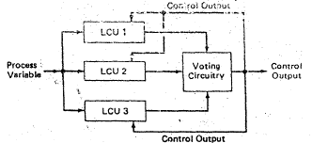
Security design approaches
(i) Manual backup
(ii) Redundant controller
(iii) Multiple active LCUs

Slide 36
Online diagnostics
Frequency of diagnostics- during start up, at regular intervals and upon occurrence of failure
Onset of failure/shutdown, the LCU
should communicate the failure to LL and HL interfaces
should initiate hardware failure indicator/alarm
should be able to trigger internal process fail safe sequence and isolate the process
Safety precaution operations to shut down in orderly way

Slide 37
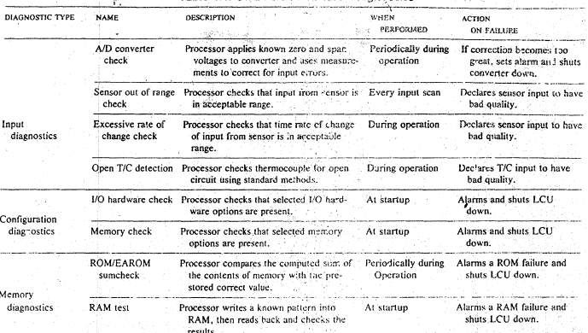
Types of online diagnostics

Slide 38
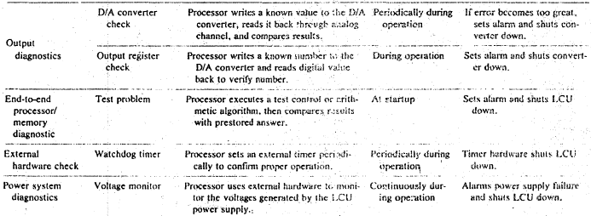
Types of online diagnostics

Slide 39
Redundancy concept
One-on-one
One-on-many
Multiple active

Slide 40
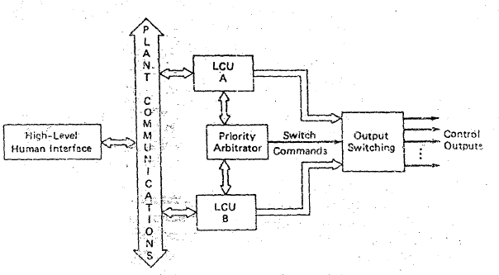
One on one redundancy
Total backup of LCU configurations to primary LCU
No manual back up needed
But expensive approach as all of the LCU elements needs to be duplicated and the redundant one has be safeguarded and has potential single point failure problems

Slide 41
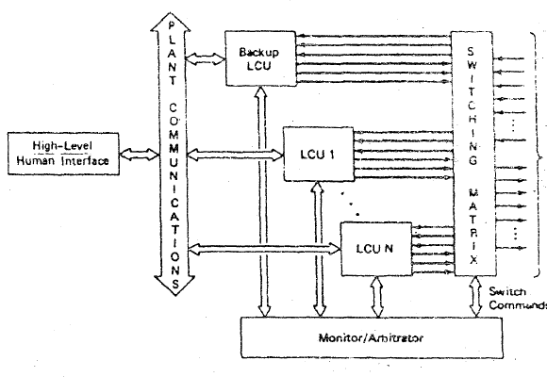
One on many redundancy
Cost effective approach – single LCU is used as standby to backup any one of the several LCUs
Switching matrix essential, complex and so careful design needed
An arbitrator should carry the information regarding the LCU

Slide 42
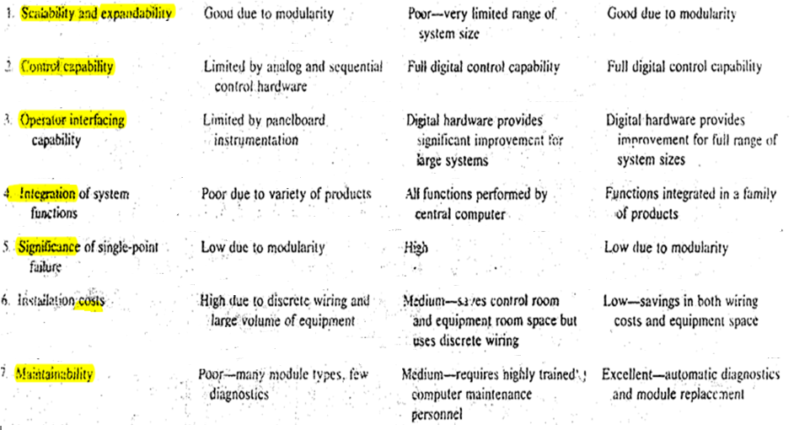
Comparison of architectures
Feature
Hybrid control
Centralized control
Distributed control

Slide 43
References
Book references:
Krishna Kant, Computer Based Industrial Control, Second edition, Prentice Hall of India, New Delhi,2015
Michael P Lukas, Distributed Control Sytems- their evaluation and design, Van Nostrand Reinhold company, USA, 1986
Video references:
Introduction to DCS
https://www.youtube.com/watch?v=jXRksET5vNo
Difference Between PLC and DCS
https://www.youtube.com/watch?v=iF99iKlDpxA

